Slide 1

Note: The data and information in this document is reflective of a hypothetical situation and client. This document is to be used for KPMG Virtual Internship purposes only.
Sprocket Central Pty Ltd
Data analytics approach
[Division Name] - [Engagement Manager], [Senior Consultant], [Junior Consultant]

Slide 2
Note: The data and information in this document is reflective of a hypothetical situation and client. This document is to be used for KPMG Virtual Internship purposes only.
Agenda
Introduction
Data Exploration
Model Development
Interpretation

Slide 3
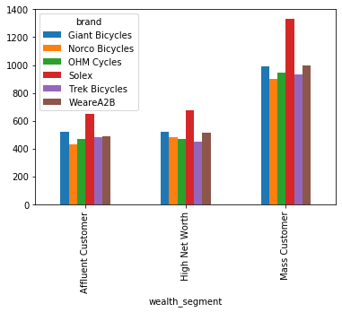
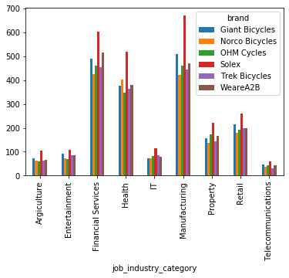
Note: The data and information in this document is reflective of a hypothetical situation and client. This document is to be used for KPMG Virtual Internship purposes only.
Introduction
Solex is the most bought brand in every job industry category and in wealth segment followed by Giant Bicycles.
Health Sector is buying more of ‘Norco Bicycles’ Brand.

Slide 4
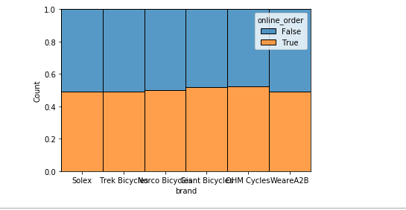
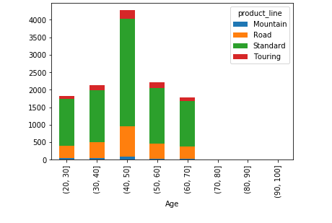
Note: The data and information in this document is reflective of a hypothetical situation and client. This document is to be used for KPMG Virtual Internship purposes only.
Data Exploration
40-50 years of Age group is contributing to the highest sales.
Every Age group buys more ‘Standard’ product line followed by ‘Road’.
Place any supporting images, graphs, data or extra text here.

Slide 5
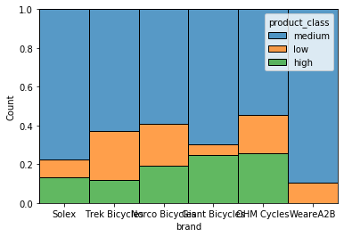
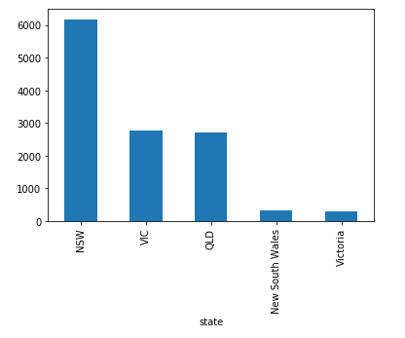
Note: The data and information in this document is reflective of a hypothetical situation and client. This document is to be used for KPMG Virtual Internship purposes only.
Data Exploration
The Medium class product is bought more followed by High class. NSW state has the highest sales, followed by VC and OLD.
Place any supporting images, graphs, data or extra text here.

Slide 6
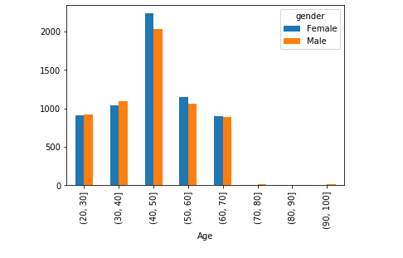
Note: The data and information in this document is reflective of a hypothetical situation and client. This document is to be used for KPMG Virtual Internship purposes only.
Data Exploration
There are predominantly more female buyers in age groups 40 – 60. In other age groups, the proportion is almost same.
Place any supporting images, graphs, data or extra text here.

Slide 7
Note: The data and information in this document is reflective of a hypothetical situation and client. This document is to be used for KPMG Virtual Internship purposes only.
Data Exploration
40-50 years of Age group is contributing to the highest sales.
Every Age group buys more ‘Standard’ product line followed by ‘Road’.
Place any supporting images, graphs, data or extra text here.

Slide 8
Note: The data and information in this document is reflective of a hypothetical situation and client. This document is to be used for KPMG Virtual Internship purposes only.
Data Exploration
The Medium class product is bought more followed by High class. NSW state has the highest sales, followed by VC and OLD.
Place any supporting images, graphs, data or extra text here.

Slide 9
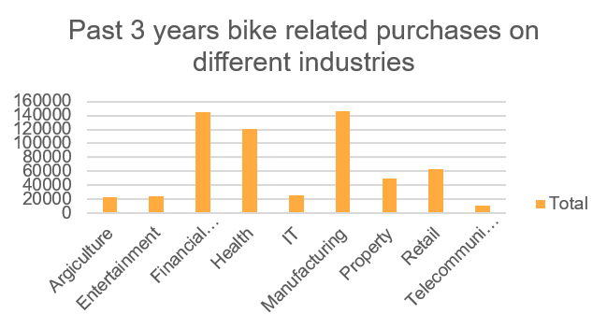
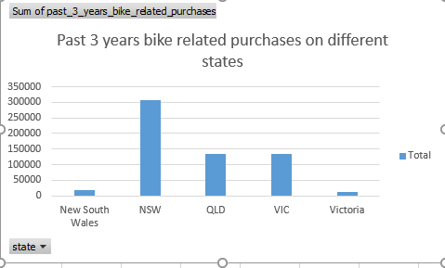
Note: The data and information in this document is reflective of a hypothetical situation and client. This document is to be used for KPMG Virtual Internship purposes only.
Data Exploration
Manufacturing, Financial and Health sector customer contribute to highest bike related purchases in last 3 years and state NSW has highest number of purchases followed by VIC and OLD.
Place any supporting images, graphs, data or extra text here.

Slide 10
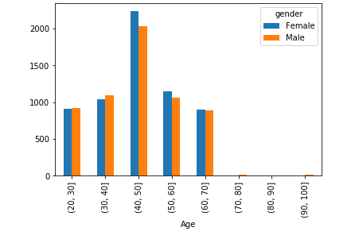
Note: The data and information in this document is reflective of a hypothetical situation and client. This document is to be used for KPMG Virtual Internship purposes only.
Data Exploration
There are predominantly more female buyers in age groups 40 – 60. In other age groups, the proportion is almost same.
Place any supporting images, graphs, data or extra text here.

Slide 11
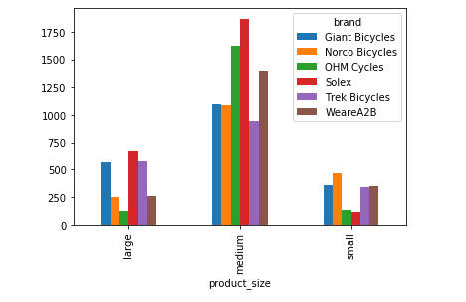
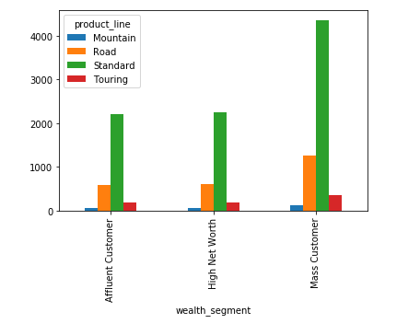
Note: The data and information in this document is reflective of a hypothetical situation and client. This document is to be used for KPMG Virtual Internship purposes only.
Data Exploration
The Product line “Standard” is sold more in all wealth segments.
Product size “Medium” is having high sales in all brands.
Place any supporting images, graphs, data or extra text here.

Slide 12
Note: The data and information in this document is reflective of a hypothetical situation and client. This document is to be used for KPMG Virtual Internship purposes only.
Model Development
Classifying and Targeting High value customers
The customers having the below factors should be considered as High value customers:
The customers from “Mass Customer” wealth segment.
The customers from Finance, Health and Manufacturing sectors.
Female customers.
Customers of Age 40-50 years.
Customers from NSW, OLD and VIC states.

Slide 13
Note: The data and information in this document is reflective of a hypothetical situation and client. This document is to be used for KPMG Virtual Internship purposes only.
Interpretation
From carrying out Exploratory Data Analysis, it is also found that the following products and types are sold in large quantities.
The products with “Standard” product line.
Solex, Giant Bicycles, WeareA2B brands are sold more in all wealth segments, so should be given priority in selling.
“Medium” sized products should be promoted more as it is sold more in all brands.
Thus on carrying out data cleaning and EDA using python, the above insights were found. Implementation of solutions as suggested above, if followed will result in higher sales.

Slide 14
Note: The data and information in this document is reflective of a hypothetical situation and client. This document is to be used for KPMG Virtual Internship purposes only.
Thankyou

